Slide 1
Exchange Server Management of the Master Category List
Exchange User Group Berlin | 31. Mai 2018

Slide 2
Thomas Stensitzki
Enterprise Consultant Granikos GmbH & Co. KG MVP | MCT @stensitzki thomas.stensitzki@granikos.eu
Torsten Schlopsnies
@t_eschl torsten.schlopsnies@mailbox.org

Slide 3
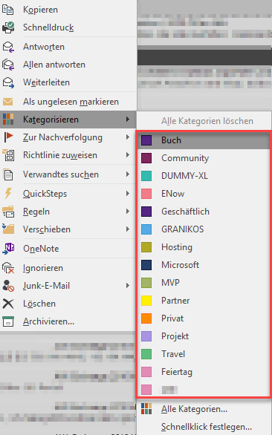
Exchange Server
What is the Master Category List?
Provides Categories for
Email message
Appointments and meetings
Tasks
Available in Outlook and Outlook on the Web

Slide 4
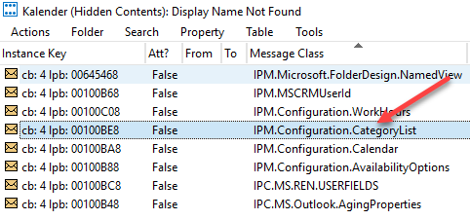
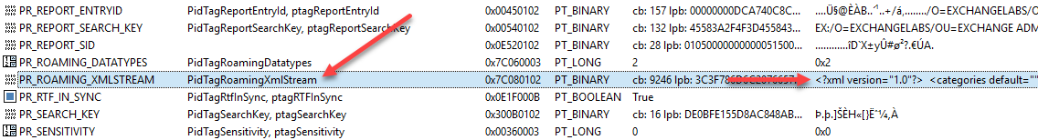
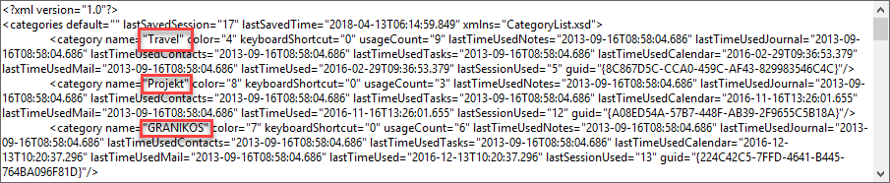
MFC Mapi
Where is the Master Category List stored?
Xml as Roaming XmlStream in Calendar‘s Associated Content folder

Slide 5

Master Category List Manager
Anwendungsszenarien
User Mailbox
User / Shared Mailbox
Master Category List Manager
Shared Mailbox
Teams Mailbox - Calendar
Xml-File

Slide 6

Master Category List Manager
Demo

Slide 7
Master Category List Manager
Code
Github https://github.com/Apoc70/MailboxCategoryListManager
Feature Requests and Issues https://github.com/Apoc70/MailboxCategoryListManager/issues

Slide 8

Thomas Stensitzki
Enterprise Consultant Granikos GmbH & Co. KG MVP | MCT
@stensitzki
http://www.stensitzki.de
Torsten Schlopsnies @t_eschl

